Slide 1
Costing ,Scheduling and Tracking Techniques

Slide 2
Cost estimation
To estimate how much software-engineering time will be required to do some work.
Elapsed time
The difference in time from the start date to the end date of a task or project.
Development effort
The amount of labour used in person-months or person-days.
To convert an estimate of development effort to an amount of money:
You multiply it by the weighted average cost (burdened cost) of employing a software engineer for a month (or a day).

Slide 3
Example
In your organization, although the average salary is $4,000 /month, the weighted average salary for cost estimation purposes is $11,000/month. You have determined that a particular project will take 7 person-months to complete. How much would you estimate this project will cost financially?
You estimate that the project will cost 7×$11,000 = $77,000.

Slide 4
Principles of effective cost estimation
Principle 1: Divide and conquer.
To make a better estimate, you should divide the project up into individual subsystems.
Then divide each subsystem further into the activities that will be required to develop it.
Next, you make a series of detailed estimates for each individual activity.
And sum the results to arrive at the grand total estimate for the project.

Slide 5
Principles of effective cost estimation
Principle 2: Include all activities when making estimates.
The time required for all development activities must be taken into account.
Including:
Prototyping
Design
Inspecting
Testing
Debugging
Writing user documentation
Deployment.

Slide 6
Principles of effective cost estimation
Principle 3: Base your estimates on past experience combined with knowledge of the current project.
If you are developing a project that has many similarities with a past project:
You can expect it to take a similar amount of work.
Base your estimates on the personal judgement of your experts
or
Use algorithmic models developed in the software industry as a whole by analyzing a wide range of projects.
They take into account various aspects of a project’s size and complexity, and provide formulas to compute anticipated cost

Slide 7
Algorithmic models
Allow you to systematically estimate development effort.
Project managers base their estimates on factors such as the following
The number of use cases
The number of distinct requirements
The number of classes in the domain model
The number of widgets in the prototype user interface
An estimate of the number of lines of code

Slide 8
Algorithmic models
A typical algorithmic model uses a formula like the following:
COCOMO
Functions Points:

Slide 9
COCOMO MODEL
(Constructive Cost Model)
Most widely used software estimation model.
COCOMO predicts the efforts and schedule of a software product.

Slide 10
COCOMO Models
COCOMO is defined in terms of three different models:
the Basic model,
the Intermediate model, and
the Detailed model.
The more complex models account for more factors that influence software projects, and make more accurate estimates.
2

Slide 11
The Development mode
the most important factors contributing to a project's duration and cost is the Development Mode
Organic Mode: The project is developed in a familiar, stable environment, and the product is similar to previously developed products. The product is relatively small, and requires little innovation.
Semidetached Mode: It is an intermediate (in terms of size and complexity) project. The project's characteristics are intermediate between Organic and Embedded.
3

Slide 12
The Development mode
Embedded Mode:
The project is characterized by tight, inflexible constraints and interface requirements.
An embedded mode project will require a great deal of innovation.
This project having a high level of complexity with a large team size by considering all sets of parameters (software, hardware and operational).

Slide 13
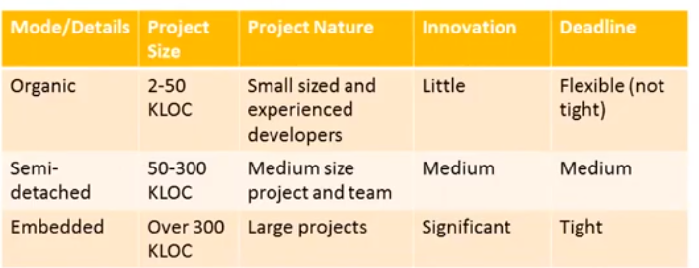
The Development mode

Slide 14
Basic COCOMO model
Computes software development effort (and cost) as function of program size expressed in estimated lines of code
Model:
Category | a_{b} | b_{b} | c_{b} | d_{b}
Organic | 2.4 | 1.05 | 2.5 | 0.38
Semi-detached | 3.0 | 1.12 | 2.5 | 0.35
Embedded | 3.6 | 1.20 | 2.5 | 0.32
5

Slide 15
Basic COCOMO Equations
E = akLOC^{b} D = cE^{d}
where
E is effort in person-months
D is development time in months
kLOC is estimated number of lines of code
6

Slide 16
Basic COCOMO Equations
P=E/D
P- Total number of persons required to accomplish the project

Slide 17
Merits
Good for quick,early,rough order of estimates
Limitations:
Accuracy is limited
Does not consider certain factors(personalquality,experience,tools)

Slide 18
Example
For a given project was estimated with a size of 300 KLOC. Calculate the Effort, Scheduled time for development. Also, calculate the Average staff size and Productivity of the software for Organic project type.
Ans: Given estimated size of project is: 300 KLOC
For Organic
Effort (E) = a*(KLOC)^{b} = 2.4*(300)^{1.05} = 957.61 PM Scheduled Time (D) = c*(E)^{d} = 2.5*(957.61)^{0.38} = 33.95 Months(M)

Slide 19
Example
Avg. staff Size(P) = E/D = 957.61/33.95 = 28.21 Persons
Productivity of Software = KLOC/E = 300/957.61 = 0.3132 KLOC/MM = 313 LOC/MM

Slide 20
Intermediate COCOMO
Computes software development effort as a function of program size and a set of “cost drivers” that include subjective assessments of product, hardware, personnel, and project attributes.
Give rating to 15 attributes, from “very low” to “extra high”, find effort multipllier (from table) and product of all effort multipliers gives an effort adjustment factor (EAF)

Slide 21
Cost Driver Attributes
Product attributes
Required reliability
Database size
Product complexity
Computer attributes
Execution time constraint
Main storage constraint
Virtual machine volatility
Computer turnaround time

Slide 22
Cost Driver Attributes (Continued)
Personnel attributes
Analyst capability, Programmer capability
Applications experience
Virtual machine experience
Programming language experience
Project attributes
Use of modern programming practices
Use of software tools
Required development schedule

Slide 23
Intermediate COCOMO Equation
Category | a_{i} | b_{i}
Organic | 3.2 | 1.05
Semi-detached | 3.0 | 1.12
Embedded | 2.8 | 1.20
E = akLOC^{b} × EAF
where
E is effort in person-months,
kLOC is estimated number of lines of code
15

Slide 24
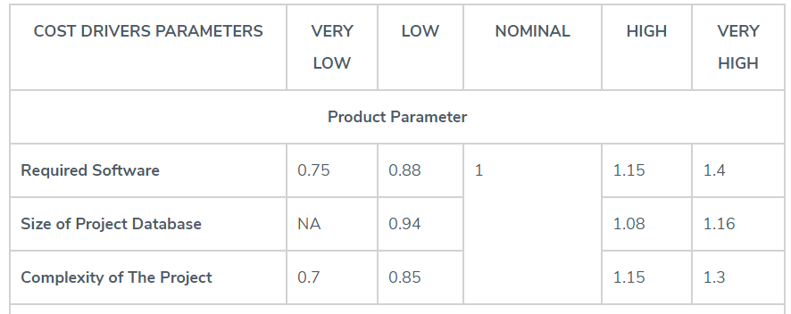
EAF Parameter values

Slide 25
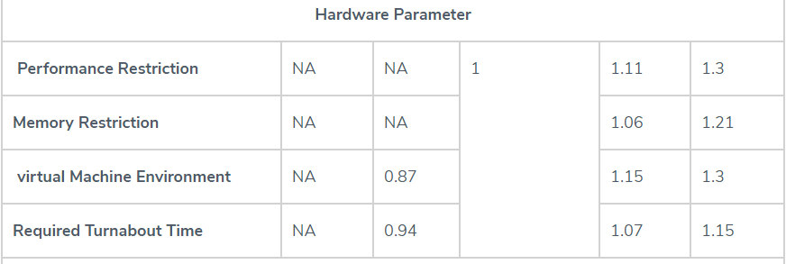
EAF Parameter values

Slide 26
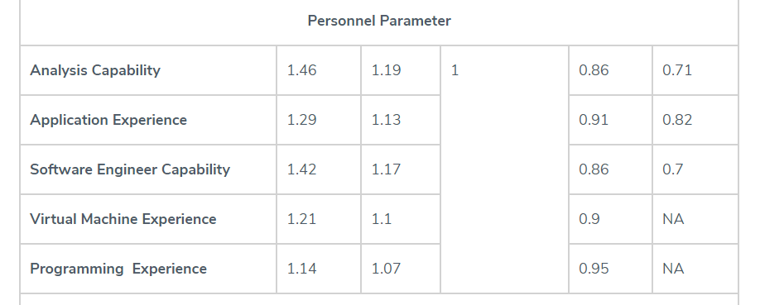
EAF Parameter values

Slide 27
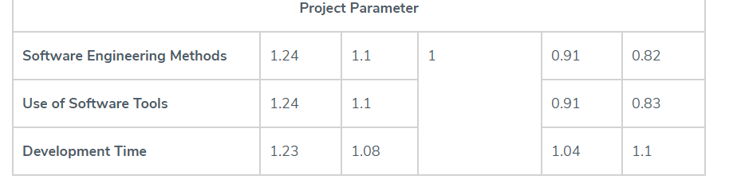
EAF Parameter values

Slide 28
Example
For a given project was estimated with a size of 300 KLOC. Calculate the Effort, Scheduled time for development by considering developer having very high application experience and very low experience in programming.
Ans:
Given the estimated size of the project is: 300 KLOC Developer having highly application experience: 0.82 (as per above table) Developer having very low experience in programming: 1.14(as per above table)

Slide 29
Example
EAF = 0.82*1.14 = 0.9348 Effort (E) = a*(KLOC)^{b} *EAF = 3.0*(300)^{1.12} *0.9348 = 1668.07 PM Scheduled Time (D) = c*(E)^{d} = 2.5*(1668.07)^{0.35} = 33.55 Months(M)

Slide 30
Advanced COCOMO
Incorporates all characteristics of intermediate COCOMOwith an assessment of the cost driver’s impact on each step of software engineering process.
17

Slide 31
COCOMO 2 models
COCOMO 2 incorporates a range of sub-models that produce increasingly detailed software estimates.
The sub-models in COCOMO 2 are:
Application composition model. Used when software is composed from existing parts.
Early design model. Used when requirements are available but design has not yet started.
Reuse model. Used to compute the effort of integrating reusable components.
Post-architecture model. Used once the system architecture has been designed and more information about the system is available.

Slide 32
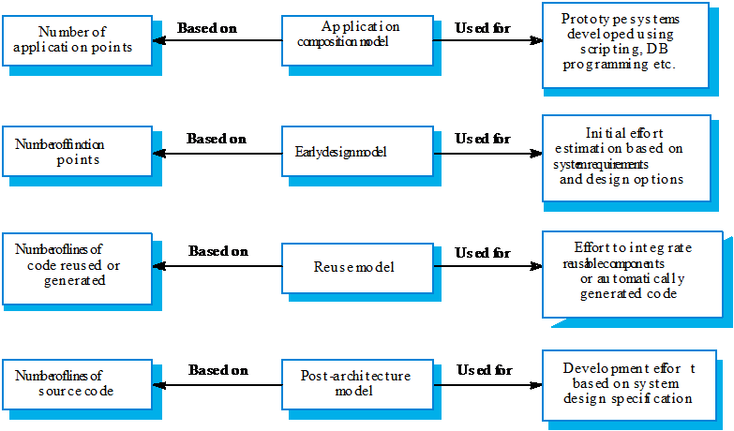
Use of COCOMO 2 models

Slide 33
Principles of effective cost estimation
Principle 4: Be sure to account for differences when extrapolating from other projects.
Different software developers
Different development processes and maturity levels
Different types of customers and users
Different schedule demands
Different technology
Different technical complexity of the requirements
Different domains
Different levels of requirement stability

Slide 34
Principles of effective cost estimation
Principle 5: Anticipate the worst case and plan for contingencies.
Develop the most critical use cases first
If the project runs into difficulty, then the critical features are more likely to have been completed
Make three estimates:
Optimistic (O)
Imagining a everything going perfectly
Likely (L)
Allowing for typical things going wrong
Pessimistic
Accounting for everything that could go wring

Slide 35
Principles of effective cost estimation
Principle 6: Combine multiple independent estimates.
Use several different techniques and compare the results.
If there are discrepancies, analyze your calculations to discover what factors causing the differences.
Use the Delphi technique.
Several individuals initially make cost estimates in private.
They then share their estimates to discover the discrepancies.
Each individual repeatedly adjusts his or her estimates until a consensus is reached.

Slide 36
Principles of effective cost estimation
Principle 7: Revise and refine estimates as work progresses
As you add detail.
As the requirements change.
As the risk management process uncovers problems.

Slide 37
Project Scheduling and Tracking
Scheduling is the process of deciding:
In what sequence a set of activities will be performed.
When they should start and be completed.
Two important scheduling techniques
PERT chart
Gantt chart
Tracking is the process of determining how well you are sticking to the cost estimate and schedule.
Important tracking technique
Earned value charts

Slide 38
PERT charts(Program Evaluation Review Technique )
A PERT chart shows the sequence in which tasks must be completed.
In each node of a PERT chart, you typically show the elapsed time and effort estimates.
One of the most important uses of a PERT chart is to determine the critical path.
The critical path indicates the minimum time in which it is possible to complete the project.
It is computed by searching for the path through the chart that has the greatest cumulative elapsed time and no idle time.

Slide 39
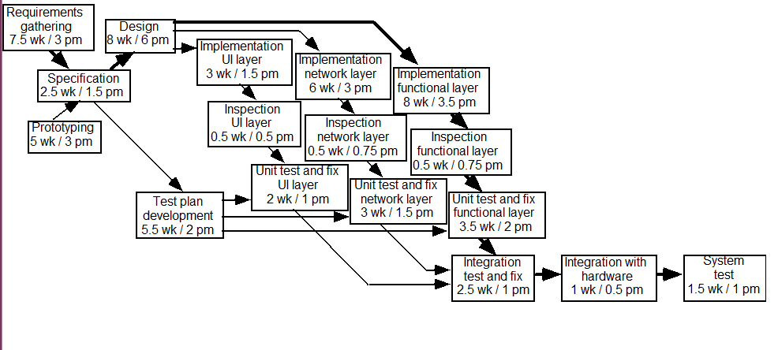
Example of a PERT chart

Slide 40
Gantt charts
A Gantt chart is used to graphically present the start and end dates of each software engineering task
One axis shows time.
The other axis shows the activities that will be performed.
The black bars are the top-level tasks.
The white bars are subtasks
The diamonds are milestones:
Important deadline dates, at which specific events may occur

Slide 41
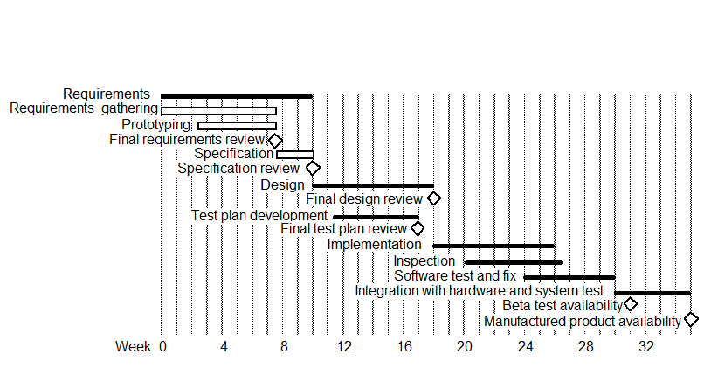
Example of a Gantt chart

Slide 42
Earned value
Earned value is the amount of work completed, measured according to the budgeted effort that the work was supposed to consume.
It is also called the budgeted cost of work performed.

Slide 43
Earned value charts
An earned value chart has three curves:
The budgeted cost of the work scheduled(planned value)
The earned value.
The actual cost of the work performed so far.

Slide 44
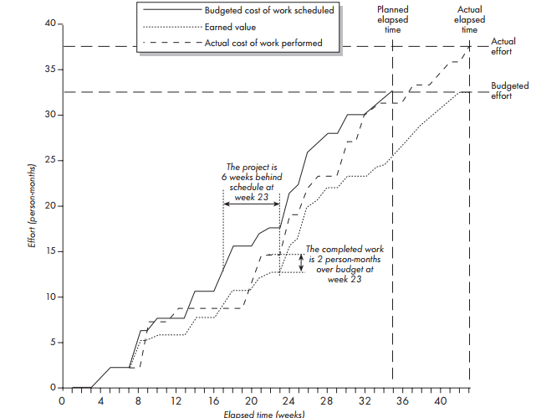
Example of an earned value chart

